Slide 1
White title slide
Distributed Shared Memory
CS 739 Final Project
Group 9
Selvaraj Anandaraj, Deep Jiten Machchhar, Vishnu Ramadas

Slide 2
Text slide: 1 column
DSM - Architecture
Virtual space shared across processes (same or different nodes)
Page-level sharing – seamless for application/client
Multiple clients allowed to read a page
Single client exclusive writes to a page
Distributed masters
Each master responsible for its own chunk of shared space
Maintains consistency for the pages
Strong consistency

Slide 3
DSM - Architecture
Client A
Client B
Client C
…….
Client N
Code, heap
Shared virtual space
Heap, stack
2^30
2^32 - 1
Master A
Master B
Master C
Page | State | Client
0 | SHARED | A, B
1 | MODIFIED | B
2 | INV

Slide 4
Text slide: 1 column
DSM – Implementation
Clients start DSM process in the background, connect with masters
Pre-defined virtual space range designated as shared
Establish connection with masters
Setup signal handler
Use shared memory as if it exists (no mallocs)
Signal Handler
Catch SIGSEGV to accesses to shared memory address
Communicate with master to get pages requested by application
Give access according to the request made by client
Master Maintains page-ClientID map in memory
Persists as key-value store, support 30 clients
1 GB shared space, 4 KB pages, 1MB meta data per master

Slide 5
Text slide: 1 column
DSM – Implementation
Strong consistency –
Per-page state
Modified – exclusive to client, read/writes allowed
Shared – many sharers, only reads allowed
Invalidate – no owner for page (init value)
Invalidate all sharers before granting write access to a client
Demote a modified owner to shared if someone asks for read access
Exclusive read state
Allow the first reader to get write permission along even though asked for read
Allows client to promote to modified without talking to master

Slide 6
Text slide: 1 column
DSM – Demo

Slide 7
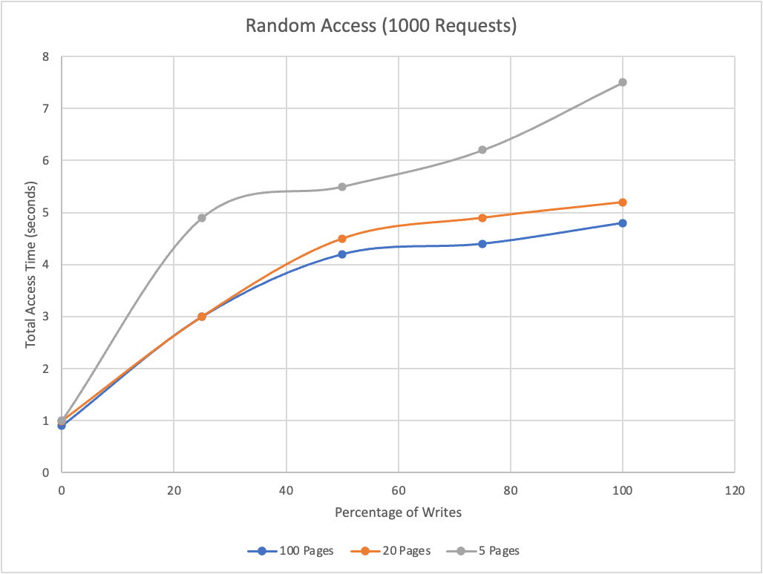
Text slide: 1 column
Results
Caching + Coherence = Reduced Network Traffic + Reduced Page Faults

Slide 8
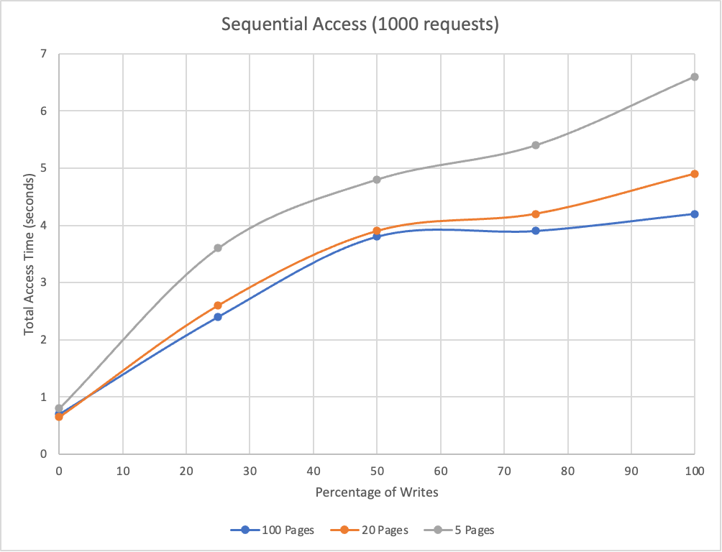
Text slide: 1 column
Results
Write intensive across clients implies more network.
Access spread across pages alleviate contention problem
Sequential access gives better performance. Why? Our Coherence Protocol

Slide 9
Distributed State Master
System targeted for sequential consistency -> So locks serializes at the masters.
Concurrency resolution strategy: last-writer wins
Why distributed master? Makes more complicated but balances load
Decreases the lock/page ratio
Helps us extract parallelism across pages

Slide 10
Text slide: 1 column
Future scope/improvements
Client-to-client forwarding
Save one master trip
Shared memory allocation library
Pre-fetching
Replication of masters through consensus

Slide 11
Black section break slide
Thank you!

